Slide 1



INTELLIGENT SALES ANALYTICS AND
FORECASTING ENGINE
Presented By,
Swathi R (811722104165)
Vignesh V (811722104180)
Vigneshwaran R(811722104181)
Guided By,
Ms. V.Sowmiya, M.E.,
DD/MM/YYYY

Slide 2
ABSTRACT
In competitive business environment, data-driven decision-making is crucial. This project introduces an Intelligent Sales Analytics and Forecasting Engine that uses natural language processing and machine learning to simplify data analysis. Users can interact through simple language queries, and the system automatically processes and provides actionable insights from large datasets. It securely manages both structured and unstructured data and supports predictive analytics to forecast trends and identify risks. Using the Prophet model, it generates real-time visual reports and summaries, making analytics accessible to non-technical users. This system enhances strategic planning, improves efficiency, and helps businesses stay competitive by enabling proactive decisions.
DD/MM/YYYY

Slide 3
OBJECTIVE
To build a browser-based sales analytics engine using Python, Gradio, and Prophet to answer business queries and forecast sales.
To collect, clean, and analyze historical sales data to identify patterns and trends.
To use machine learning models to accurately predict future sales based on past data.
To develop a natural language interface that allows users to query business data easily.
To automate the generation of visualizations and dashboards for key performance metrics.
To support conversational querying and follow-up questions for deeper data exploration.
DD/MM/YYYY

Slide 4
LITERATURE SURVEY
S.No. | Paper Title | Year | Remark
1 | Personalized Business Insights Through AI and Recommendation Systems | 2023 | AI personalization boosts BI adoption, but may require high resources, faces privacy issues, and struggles with cross-department generalization.
2 | AI-Based Self-Service BI Platforms | 2023 | Self-service BI simplifies analytics access, but may give irrelevant suggestions and risk oversimplifying key data.
3 | Cognitive BI Assistants Using NLP and Data Mining | 2022 | Cognitive assistants enhance BI insights with NLP and data mining, but need constant tuning and can miss complex patterns.
DD/MM/YYYY

Slide 5
LITERATURE SURVEY
S.No. | Paper Title | Year | Remark
4 | Business Data Analysis Using Chatbots with Machine Learning | 2022 | ML chatbots ease BI data access, yet face challenges with database compatibility and complex queries.
5 | Conversational AI for Business Intelligence: An Intelligent Assistant for Data Analytics | 2022 | Conversational AI improves BI accessibility but depends on structured data, struggles with multi-intent queries, and lacks explainability.
6 | Intelligent Data Assistants for Real-Time Decision Support | 2021 | Real-time AI assistants boost quick decisions, though limited metric scope and unpredictable learning behavior are concerns.
DD/MM/YYYY

Slide 6
LITERATURE SURVEY
S.No. | Paper Title | Year | Remark
7 | Integration of AI with Business Intelligence Dashboards | 2021 | AI dashboards personalize BI insights, but are restricted by dataset type and depend on consistent user data.
8 | Natural Language Interfaces for Business Intelligence Systems | 2021 | NLIs simplify BI tools for non-technical users, but have domain limitations and face issues with ambiguous or complex queries.
9 | AI-Driven BI Tools for Predictive Business Insights | 2020 | AI integration enables predictive BI, but relies on high-quality historical data, is industry-specific, and demands expert maintenance.
DD/MM/YYYY

Slide 7
EXISTING SYSTEM
The existing sales analytics systems are typically limited to conventional reporting tools like Excel sheets, ERP dashboards, or standalone BI applications that require manual data entry and pre-defined query structures. These systems lack real-time data integration and rely on periodic uploads, which delay access to critical business insights. Forecasting, if available, is often based on basic statistical models that do not adapt to changing patterns. Natural language querying is unsupported, making non-technical users dependent on IT teams for report generation. Visualizations are static, offering little interactivity or customization. Moreover, there is minimal use of AI for predictive insights, and decisions are reactive rather than data-driven.
DD/MM/YYYY

Slide 8
PROPOSED SYSTEM
The proposed system introduces an Intelligent Sales Analytics and Forecasting Engine that empowers users to interact with business data using natural language, without requiring technical expertise. Built using Python, Gradio, and Prophet, the system allows CSV uploads and automatically handles data preprocessing such as type detection, missing value imputation, and column normalization. It identifies relevant sales features and generates statistical insights, interactive visualizations, and time-series forecasts. Leveraging machine learning models, it predicts future sales trends with high accuracy. The user-friendly browser interface ensures accessibility, while integration with natural language processing enables dynamic querying and real-time decision support, transforming traditional sales reporting into a proactive, AI-driven solution.
DD/MM/YYYY

Slide 9
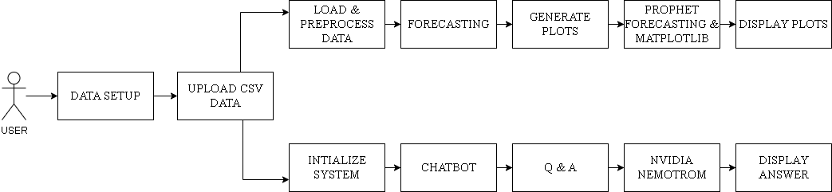
SYSTEM ARCHITECTURE
DD/MM/YYYY

Slide 10
MODULE 1 : Data Gathering and Upload
Allows users to upload business datasets, typically in CSV format, through a simple interface.
Automatically checks for file format compatibility, missing values, and inconsistent data entries.
Performs initial validation such as checking column headers, row count, and basic data structure.
Provides a real-time data preview so users can verify the uploaded content before processing begins.
Ensures a smooth, error-free data intake process that serves as the foundation for analysis.
DD/MM/YYYY

Slide 11
MODULE 2 : Data Preprocessing
Automates data cleaning using powerful Python libraries like pandas and NumPy.
Detects and converts data types (e.g., dates, numeric fields) for consistency.
Handles missing values using mean/median imputation or by removing incomplete rows.
Identifies important columns such as date, product, and sales based on naming and pattern recognition.
Detects and removes duplicate records to avoid analysis errors.
DD/MM/YYYY

Slide 12
MODULE 3 : Statistical Analysis
Performs descriptive statistical analysis including mean, median, mode, standard deviation, and variance.
Uses group-by and aggregation techniques to analyze trends across time and categories (e.g., monthly sales by product).
Applies time-series decomposition to separate seasonality, trend, and residual components.
Ranks top-performing products, regions, or time periods using sorting and ranking algorithms.
Generates clear textual summaries that explain what the numbers mean, aiding business decision-making.
DD/MM/YYYY

Slide 13
MODULE 4 : Visualization
Converts complex datasets into easy-to-understand visual charts using Matplotlib, Seaborn, and Plotly.
Creates line charts for sales trends, bar graphs for category comparisons, and pie charts for share analysis.
Includes scatter plots with trend lines to identify relationships between variables (e.g., price vs. demand).
Allows customization of color, labels, titles, and layout for clear communication.
DD/MM/YYYY

Slide 14
MODULE 5 : Forecasting
Implements Facebook Prophet for advanced time series forecasting with support for seasonality and holidays.
Fits historical sales data into the model to predict future trends, peaks, and drops.
Provides forecast intervals with upper and lower confidence bounds to express uncertainty.
Displays results as forecast plots and component plots showing trend, seasonality, and holidays separately.
Supports inventory planning, budgeting, and proactive decision-making using data-driven foresight.
DD/MM/YYYY

Slide 15
MODULE 6 : AI Query
Integrates OpenAI GPT-based models to allow natural language interaction with business data.
Understands and interprets user queries like “What were the top-selling products last month?”
Uses semantic parsing to detect user intent and retrieve relevant data or summaries.
Applies Retrieval-Augmented Generation (RAG) to enhance response relevance using historical stats.
Delivers conversational, human-readable responses, turning raw data into actionable insights.
DD/MM/YYYY

Slide 16
MODULE 7 : User Interface Module
Built using Gradio, offering a browser-based GUI accessible to non-technical users.
Buttons and dropdowns allow users to navigate functions without writing code.
Real-time updates ensure that every action (upload, forecast, query) reflects instantly in the interface.
Enhances usability and lowers the barrier to using complex AI and BI tools effectively.
DD/MM/YYYY

Slide 17
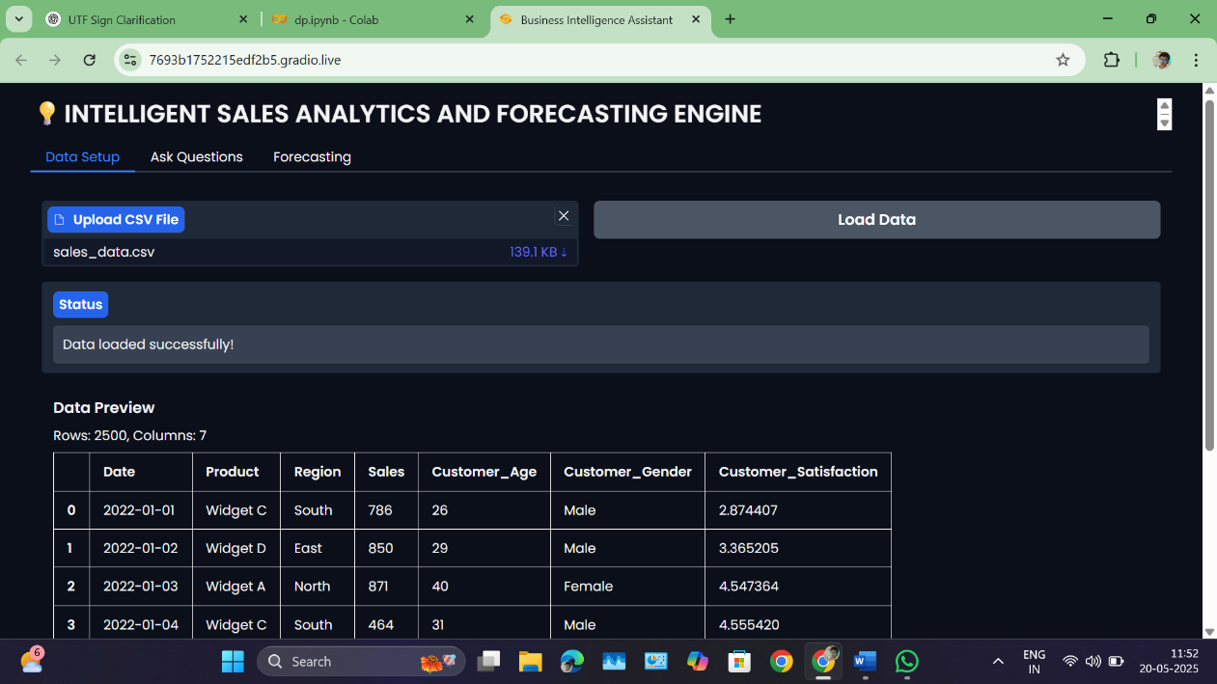
OUTPUT : Website Main Page
DD/MM/YYYY

Slide 18
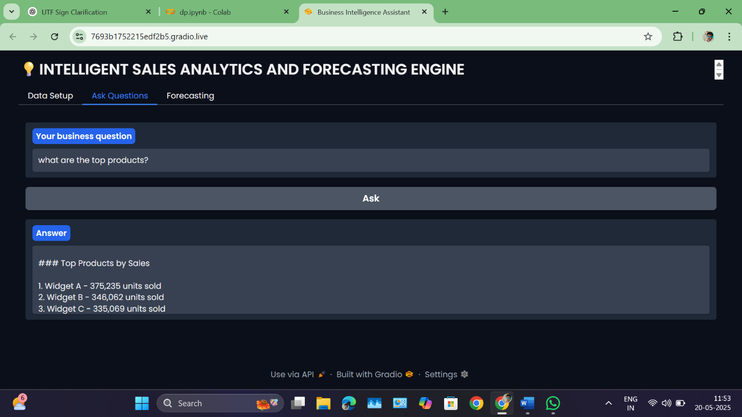
OUTPUT : Ask Questions
DD/MM/YYYY

Slide 19
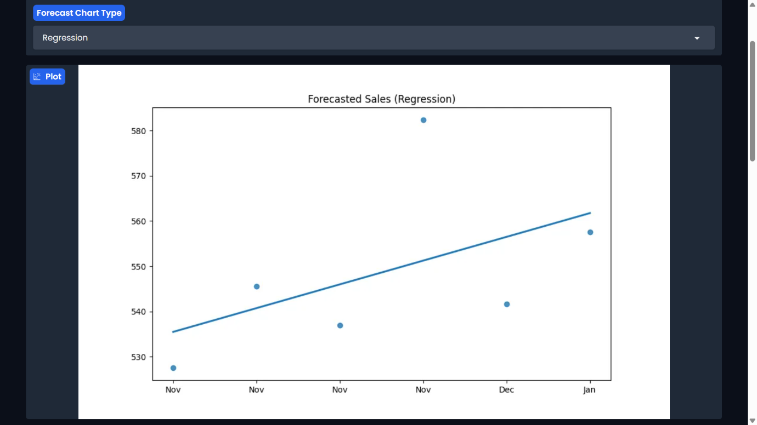
OUTPUT : Forecasting
DD/MM/YYYY

Slide 20
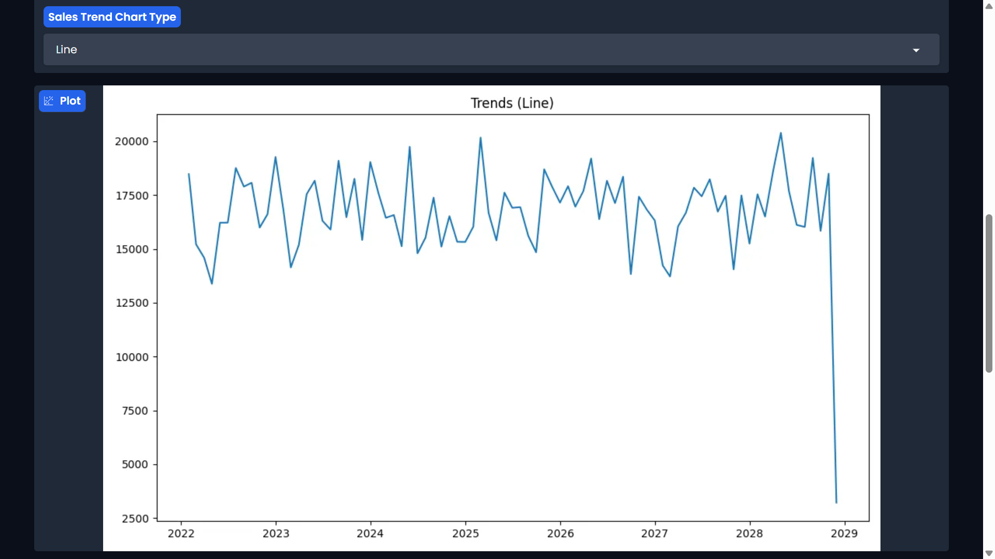
OUTPUT : Sales Trend
DD/MM/YYYY

Slide 21
CONCLUSION & FUTURE ENHANCEMENT
The project developed an AI-driven sales analytics platform that simplifies forecasting and insights through natural language interaction, dynamic visualizations, and predictive modeling. By integrating tools like Prophet and a conversational AI, it empowers non-technical users to make data-driven decisions efficiently and accurately.
Future Enhancement
Future upgrades include real-time data integration, advanced forecasting models like LSTM, voice and multilingual AI support, alert systems, personalized dashboards, and deployment on mobile and cloud platforms to enhance accessibility, scalability, and user engagement.
DD/MM/YYYY

Slide 22
REFERENCES
H. Chen, R. H. Chiang, and V. C. Storey, “Business intelligence and analytics: From big data to big impact,” MIS Quarterly, vol. 36, no. 4, pp. 1165–1188, 2012.
T. H. Davenport and D. J. Patil, “Data scientist: The sexiest job of the 21st century,” Harvard Business Review, vol. 90, no. 10, pp. 70–76, 2012.
R. Barga, V. Fontama, and W. Tok, Predictive Analytics with Microsoft Azure Machine Learning, Apress, 2014.
L. D. Xu, W. He, and S. Li, “Internet of things in industries: A survey,” IEEE Transactions on Industrial Informatics, vol. 10, no. 4, pp. 2233–2243, Nov. 2014.
C. Frye, “Forecasting with Facebook Prophet,” Practical Time Series Analysis, O'Reilly Media, pp. 101–120, 2020.
DD/MM/YYYY

Slide 23

DD/MM/YYYY

